Slide 1




SLEEP STUDY
BY MAHEK PATEL, MENGXIAO FANG, KATERINA GUEVARRA

Slide 2
Background
Average sleep time in U.S. is 7 hours
Age
Gender
Sleep Time
Type of days
Years
Notes:
Some says teenages are lack of sleeps, others says that older people tend to have less sleep. So, in this research, we are going to study on how those variables influence on sleep time, especially on the relationship between the age group and the sleep time

Slide 3
FIRST HYPOTHESIS: Are they same?
# Pairwise comparisons using paired t tests
#data: Sleep$AvgHours and Sleep$Age.Group
# 15 to 24 years 15 years and over 25 to 34 years
#15 years and over < 2e-16 - -
#25 to 34 years < 2e-16 1.00000 -
#35 to 44 years < 2e-16 < 2e-16 < 2e-16
#45 to 54 years < 2e-16 < 2e-16 < 2e-16
#55 to 64 years < 2e-16 < 2e-16 < 2e-16
#65 years and over < 2e-16 3.2e-07 7.1e-05
# 35 to 44 years 45 to 54 years 55 to 64 years
#15 years and over - - -
#25 to 34 years - - -
#35 to 44 years - - -
#45 to 54 years 4.9e-13 - -
#55 to 64 years 0.00041 1.00000 -
#65 years and over < 2e-16 < 2e-16 < 2e-16
#P value adjustment method: bonferroni
#
H0: Each age group has the same average sleep time
H1: Each age group has a different average sleep time

Slide 4
SECOND HYPOTHESIS: Older age group sleeps more?
# diff lwr upr p adj
45 to 54 years-15 to 24 years -1.01518519 -1.172571155 -0.85779922 0.0000000
65 years and over-15 to 24 years -0.53340741 -0.690793377 -0.37602144 0.0000000
65 years and over-15 years and over 0.15555556 -0.001830414 0.31294153 0.0551174
65 years and over-25 to 34 years 0.17274074 0.015354771 0.33012671 0.0208485
65 years and over-35 to 44 years 0.37962963 0.222243660 0.53701560 0.0000000
65 years and over-45 to 54 years 0.48177778 0.324391808 0.63916375 0.0000000
65 years and over-55 to 64 years 0.45659259 0.299206623 0.61397856 0.0000000

Slide 5
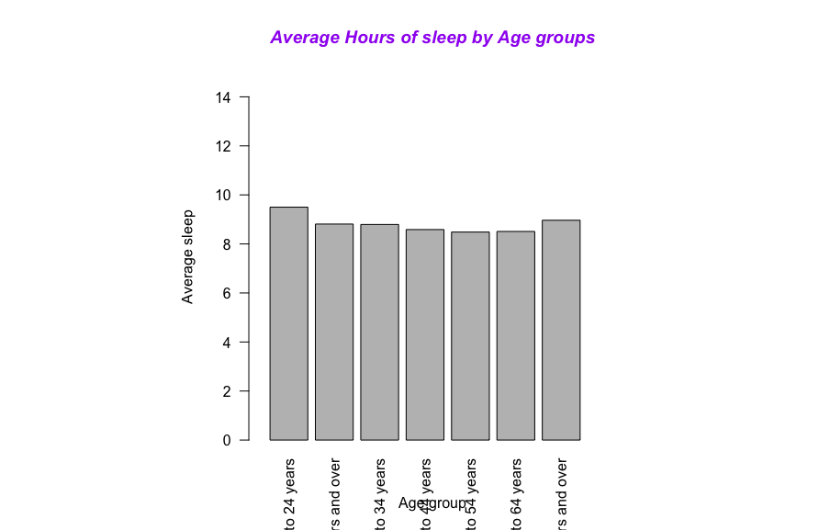
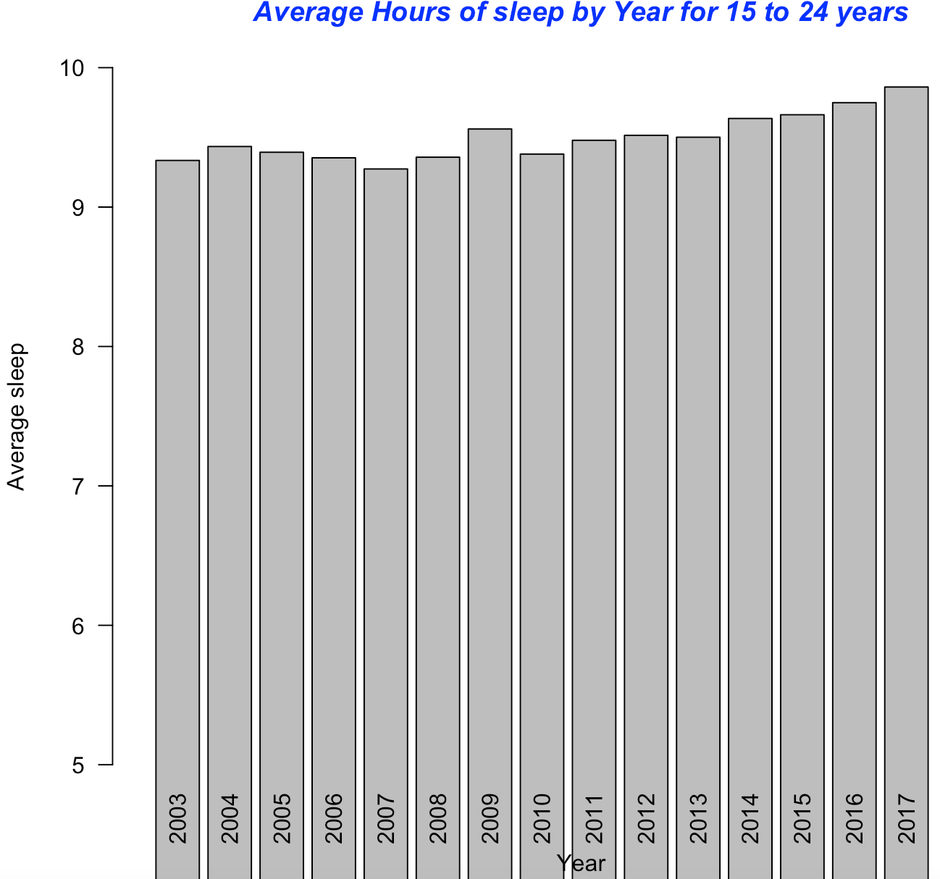
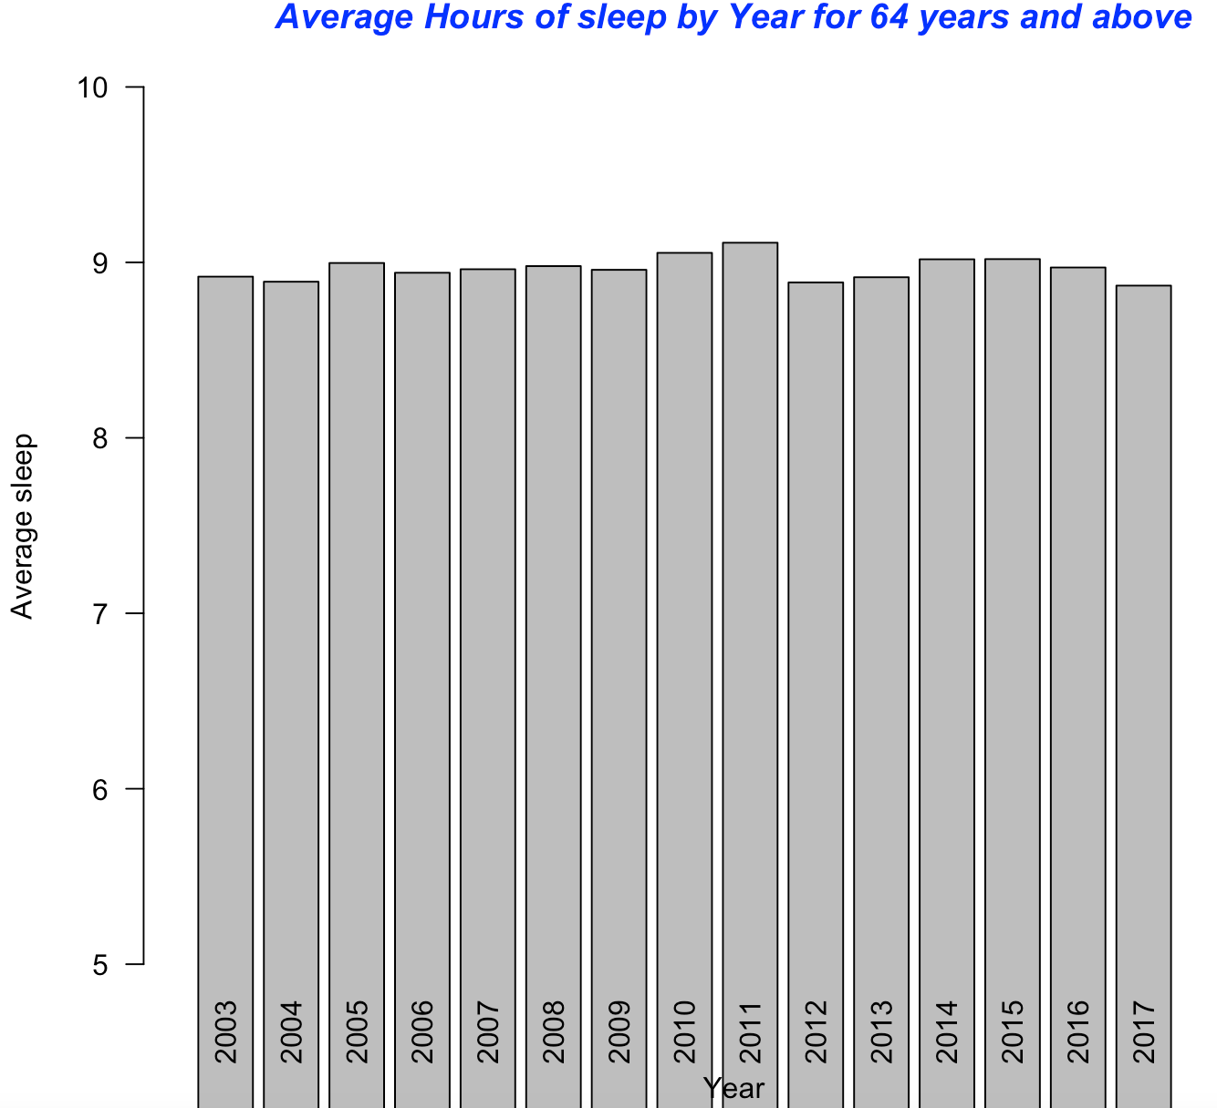
Brief Data Visualization
Bar plots:
From the Graph above, We can see that 15 to 24 years old sleep most and 65 years and over sleeps second highest.
Notes:
Then we are looking specifically on the age group of 15-24 and age above 65, … (ADD MORE)

Slide 6
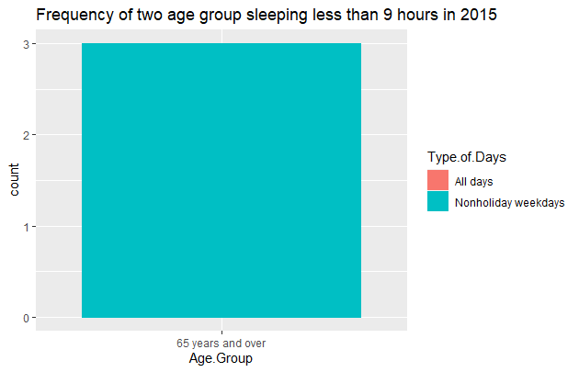
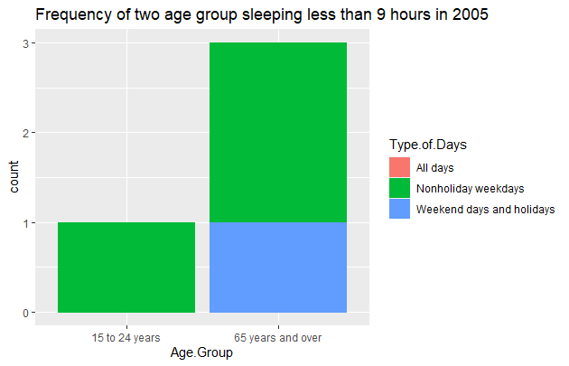
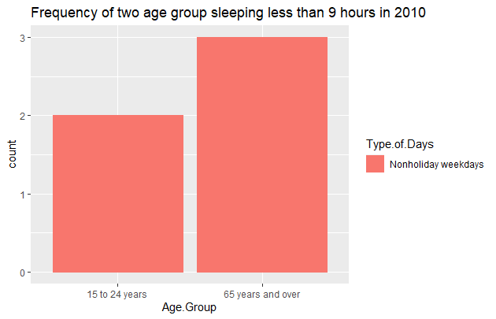
Brief Data Visualization
Stacked bar plot:
Notes:
(I DON’T KNOW THIS PART)

Slide 7
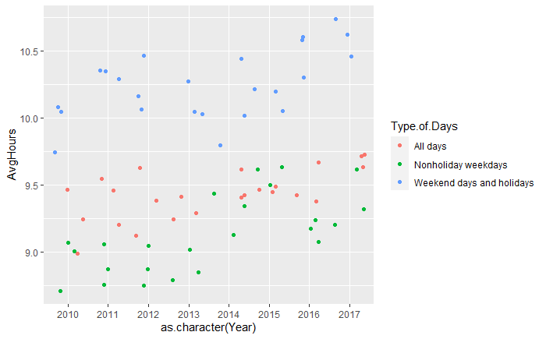
Brief Data Visualization
Jitter plot:
Weekdays sleep less, weekend and holidays sleep more.

Slide 8
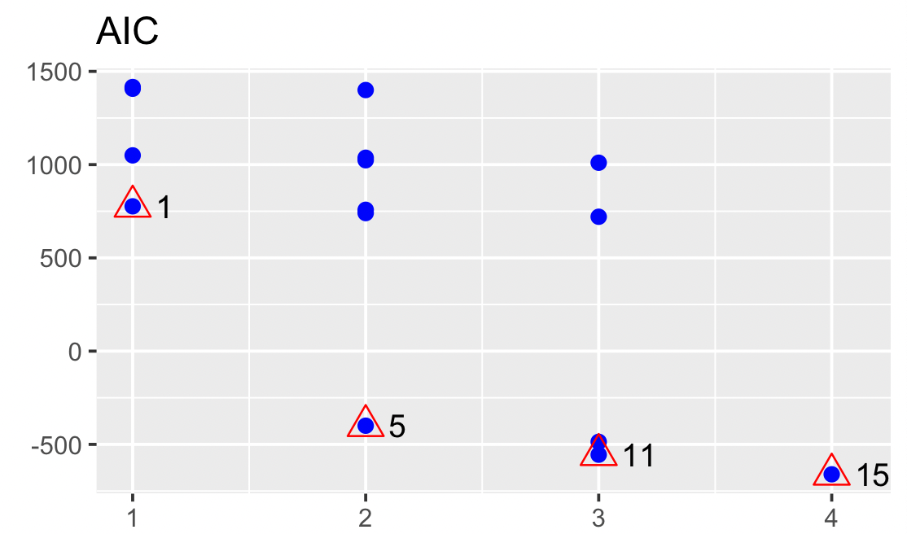
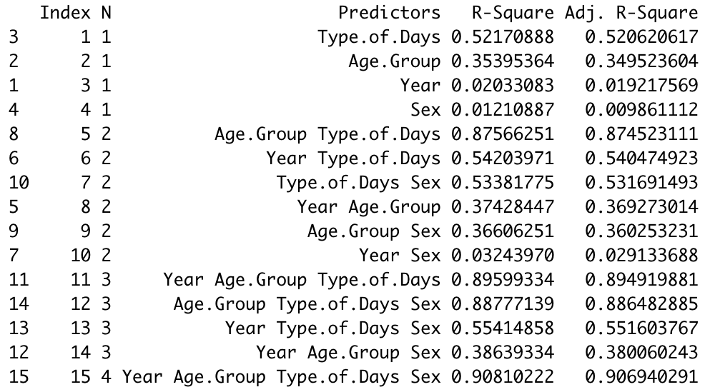
BEST LINEAR MODEL
All possible regression

Slide 9
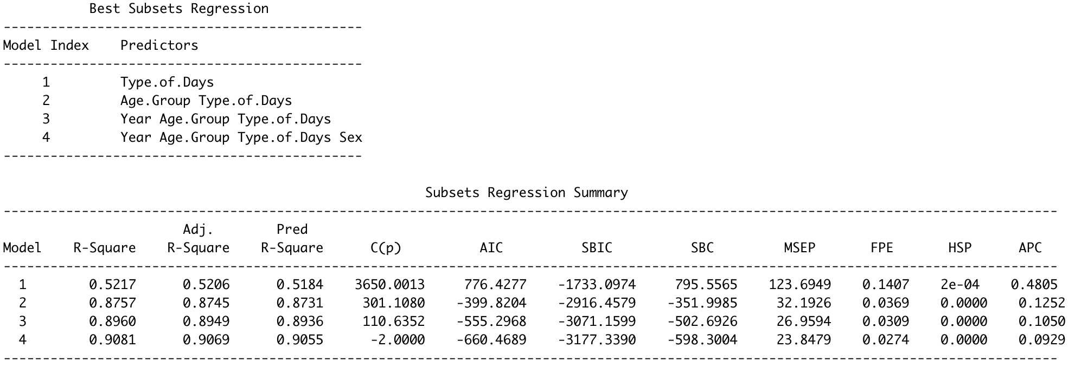
Look at the AIC and Adj. R-Squared for model index 4!
Best linear regression model contains all variables

Slide 10
Train and test dataset
Predict the average hours of sleep for the next year using:
Test data→ without data from last year 2017 (882 observations)
Train data→ data with the year 2017 (63 observations)

Slide 11
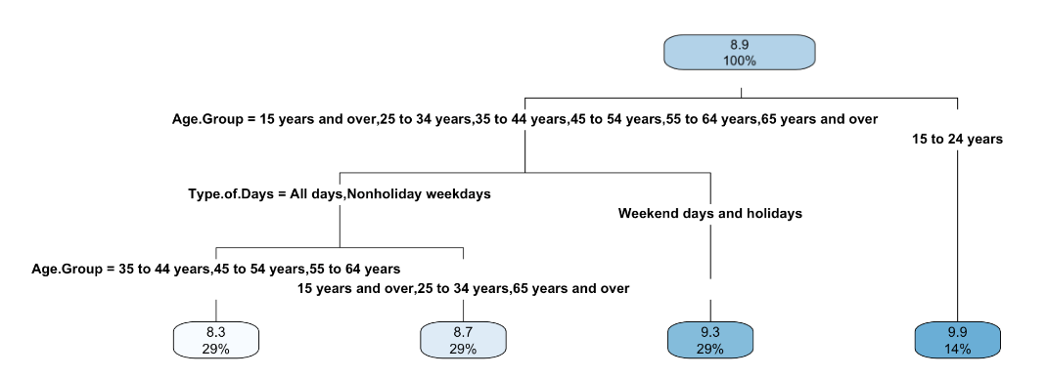
Tree
The 15 to 24 years age group has average sleep hours >8.9, about 9.9 (taking 14% of the total population from all age groups).

Slide 12
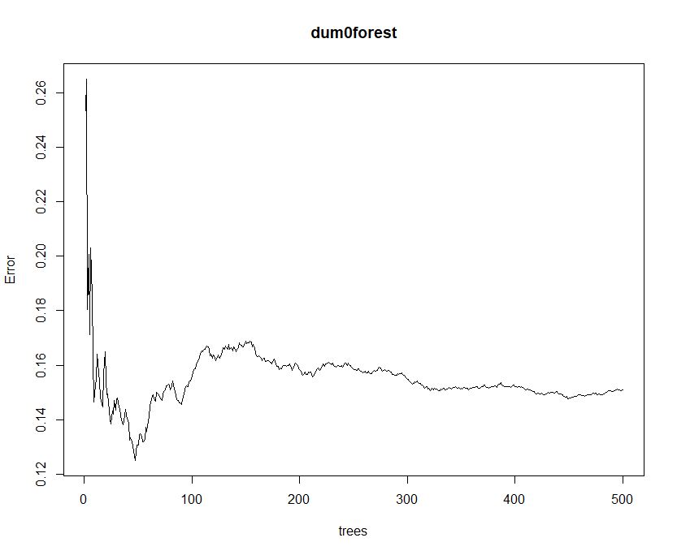
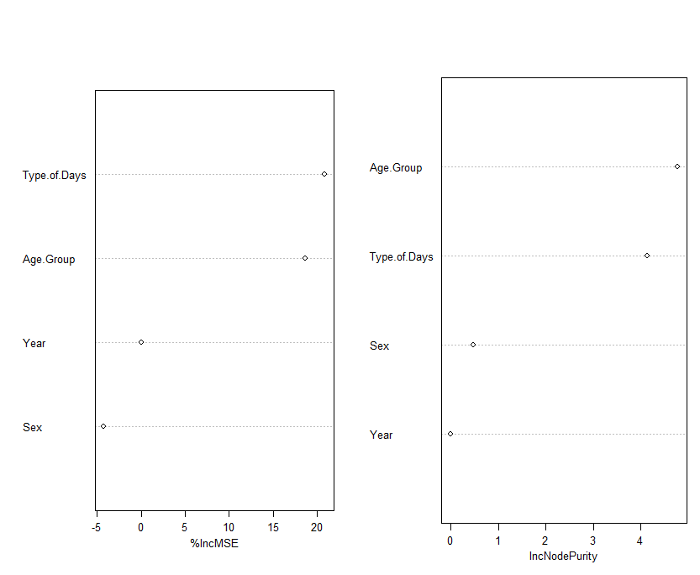
Random Forest
High importance variables:
Age. Group and Type.of.Days

Slide 13
BEST REGRESSION MODEL
Other Possible Regression: Quadratic, exponential, Linear model with Interaction terms
Model: Linear
Linear regression model with Interaction Terms:
Model1:
Model2:
Notes:
AIC BIC to determine best model

Slide 14
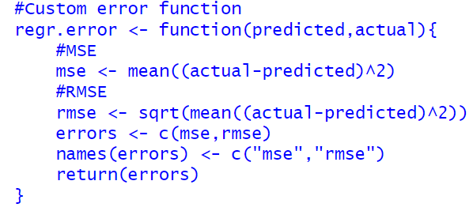



Comparing RMSE
Model:
Model1:
Model 2:
Lower RMSE and MSE indicate better fit and more accurately the model predicts.

Slide 15
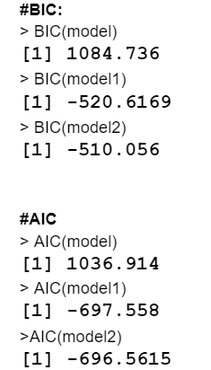
BIC and AIC:
In model comparison, the model with the lowest AIC and BIC score is preferred.

Slide 16
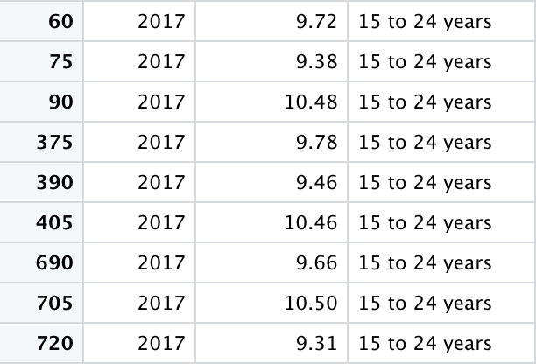
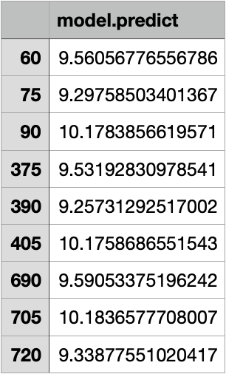
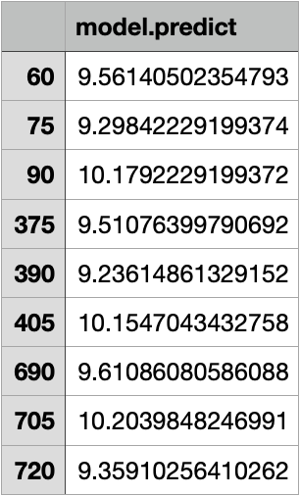
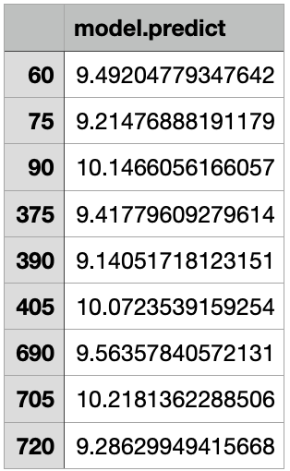
Obtained results from original data:
Using model1:
model2:
model:

Slide 17
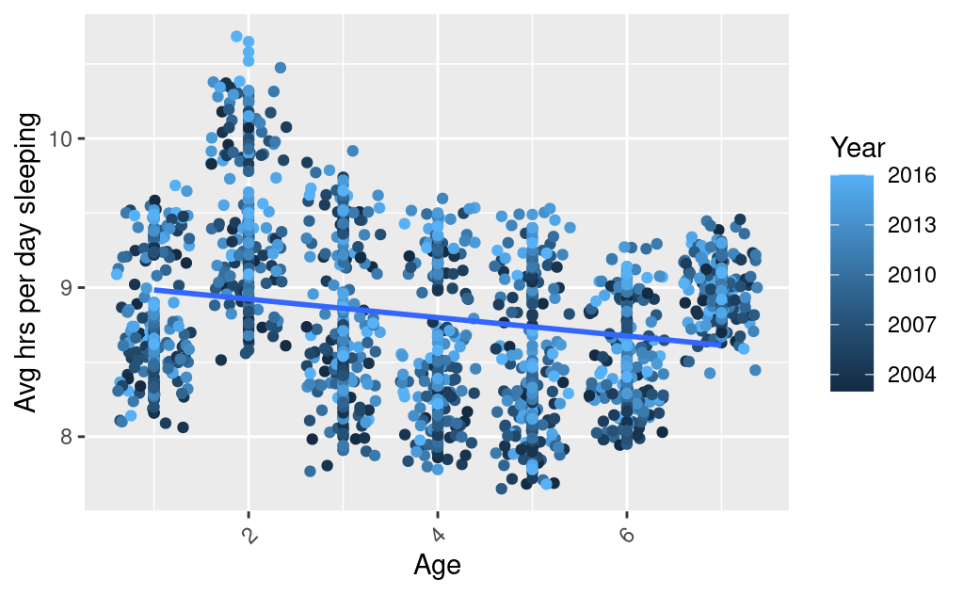
Brief Data Visualization
Jitter plot:
The trend line shows elder people sleep less in general.

Slide 18
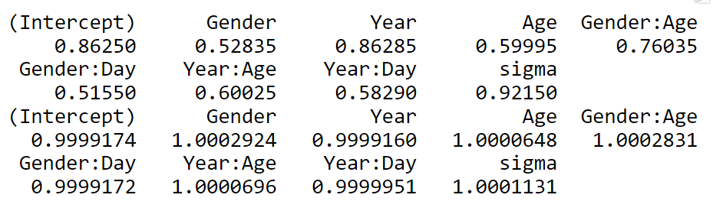
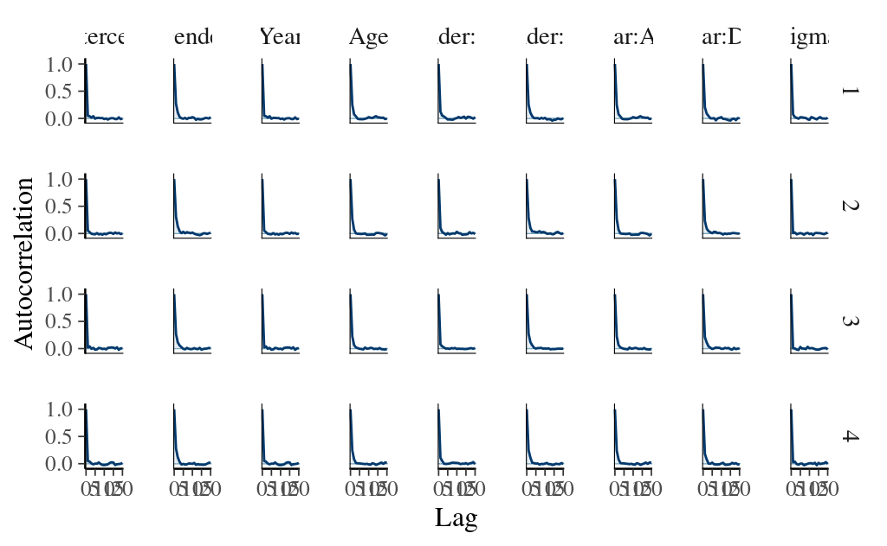
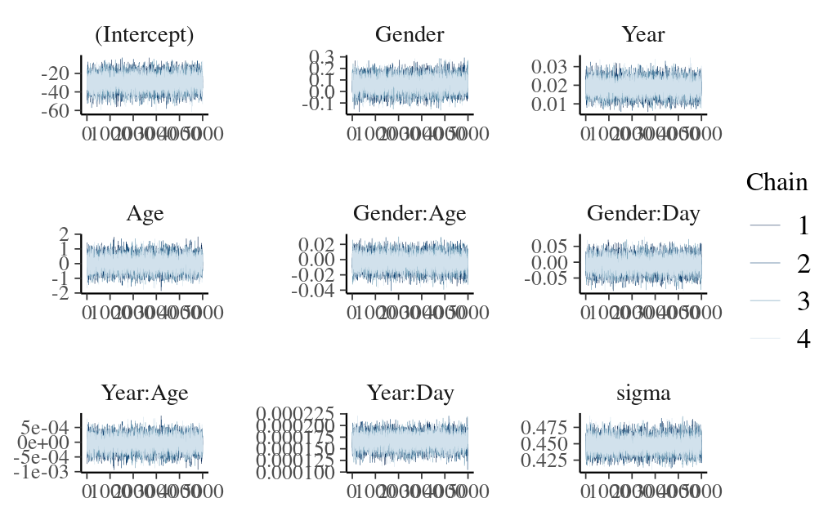
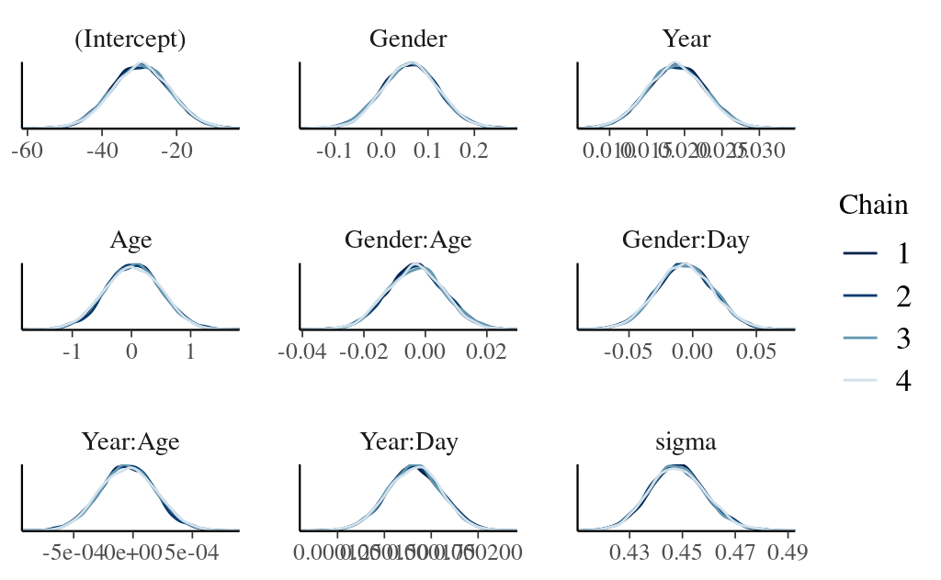
Sample size ratio:
Rhat:
Bayesian Model: Using Model 2

Slide 19
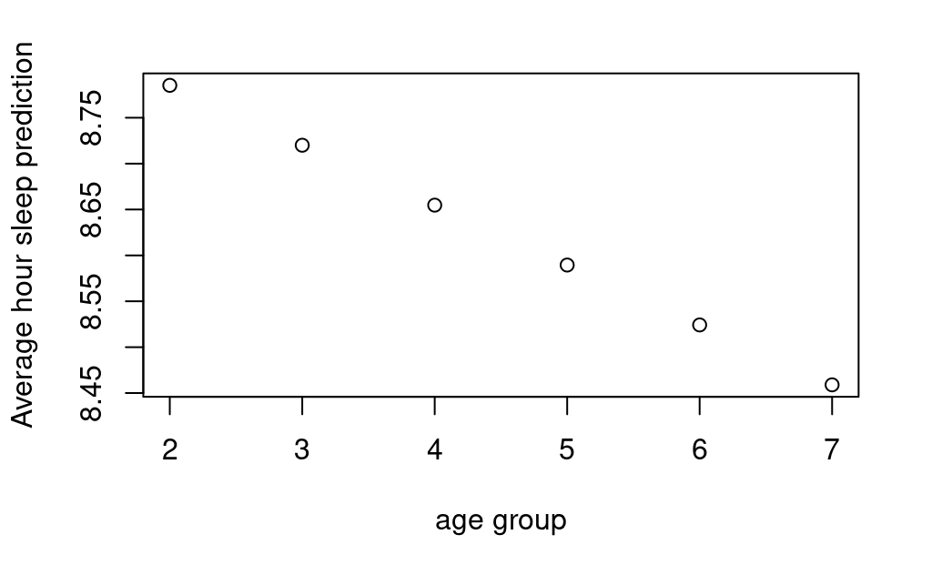
Bayesian Prediction: on year 2017
Age: 15-24
8.785299
Age: 25-34
8.720025
Age: 35-44
8.654752
Age: 45-54
8.589479
Age: 55-64
8.524205
Age: 65 and over
8.458932

